Slide 1
Project: Autonomous Shopping Cart
Project Presentation
Group 4:
1906149 – S.M. Tahmeed Reza
1906150 – Manjur Muntasir
1906151 – Samia Akter
1906152 – Md. Aktarujjaman Swan
1906153 – Md. Asif Kabir
1906154 – Tamim Hasan Bhuyian
Instructed By:
Dr. Shaikh Anowarul Fattah
Md. Jawad Ul Islam

Slide 2
Objectives
To develop a Smart Shopping system that revolutionizes the customer shopping experience.
To provide an intuitive and user-friendly interface for customers to browse and select products online.
To offer real-time product visualization through a webcam, allowing customers to inspect items remotely.
To create a line-following robot with a cart, webcam, and robotic arm for efficient and secure product collection.
To enhance customer convenience by automating the retrieval of selected items within the shopping mall.
To optimize the checkout process by automating the return of the robot to the billing counter.

Slide 3
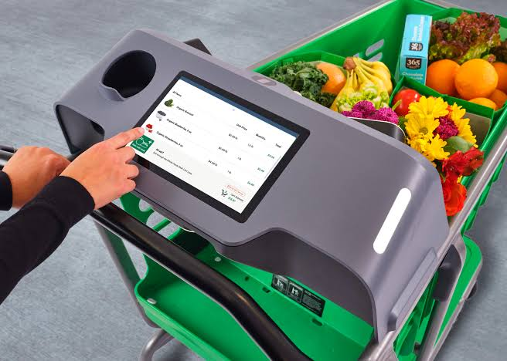
Comparison with existing market
Nearest existing rivals: Amazon’s Smart Grocery Cart

Slide 4
Workflow
User Interface
Product Selection
Line Following Robot
Real Time Product Visualization
Pickup by Robotic Arm
All Product Collection

Slide 5
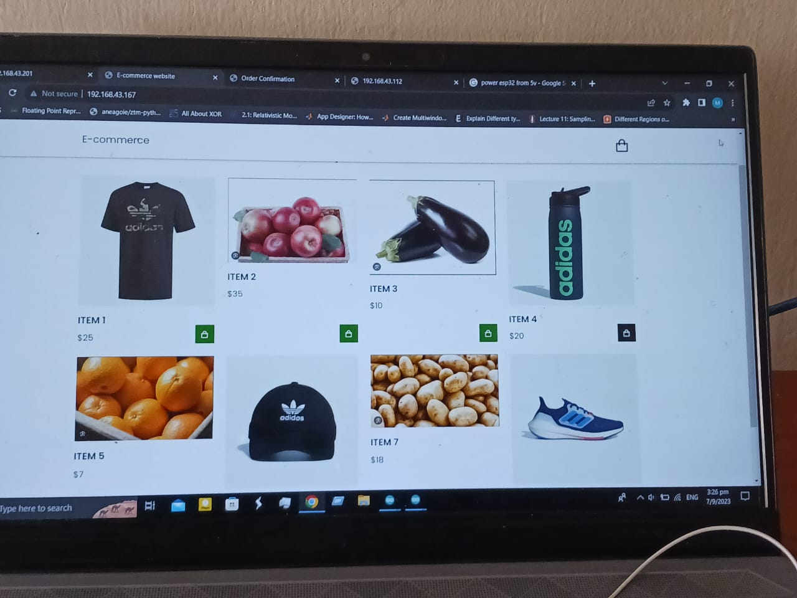
Website

Slide 6
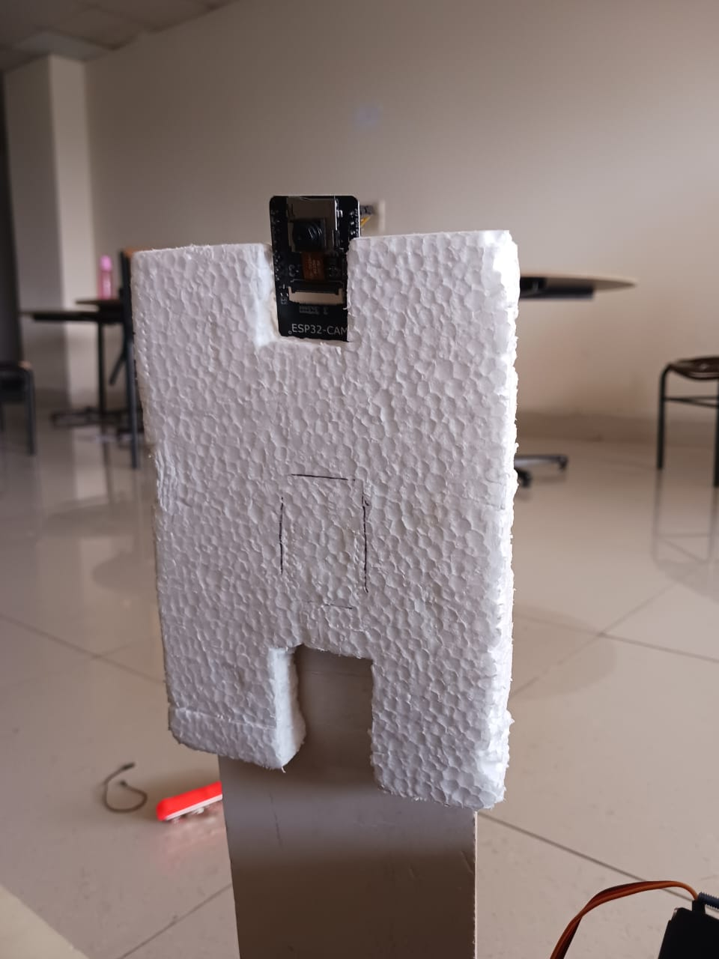
Product Visualization
Used ESP 32 Cam
Camera sensor is OV2640
Programmed in Arduino IDE

Slide 7
Webcam View in Website

Slide 8
Cart Path Setup
Path and action sequence from shopping list
Line following technolo-gy
Pre-program-med paths and actions
Execute program

Slide 9
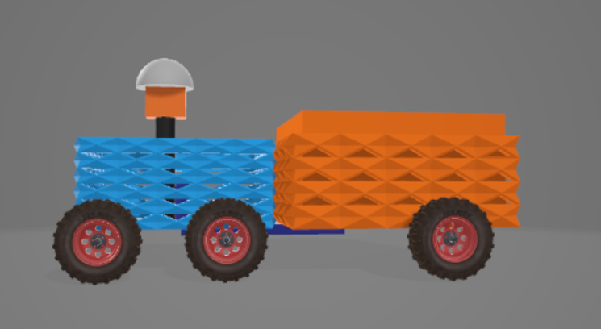
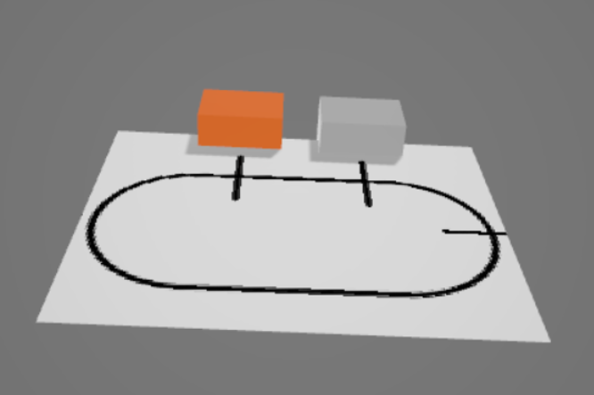
Line Follower and Cart Design

Slide 10
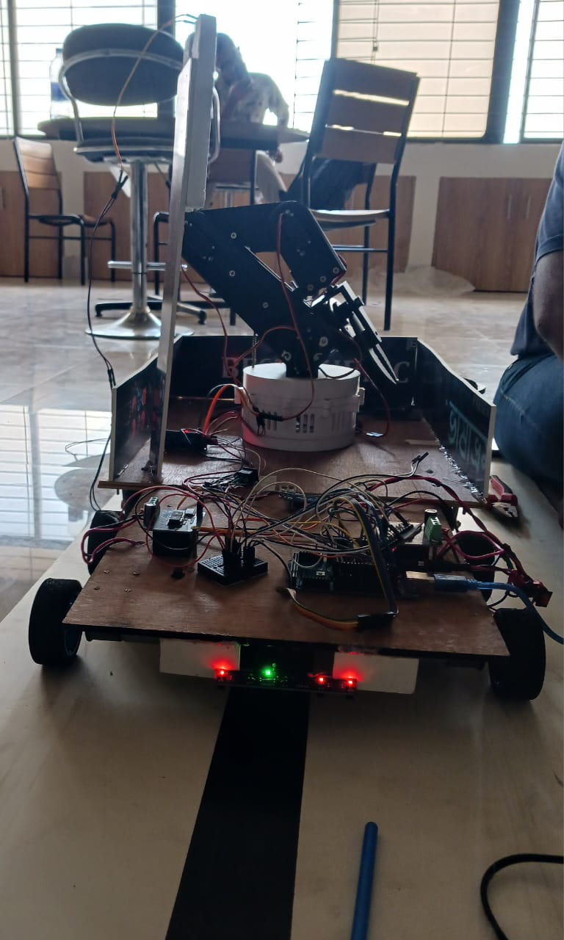
Line Follower and Cart Design

Slide 11
Line Follower Robot
Sensor
Line Detection
Data Processing
Control Algorithm
Motor Control

Slide 12
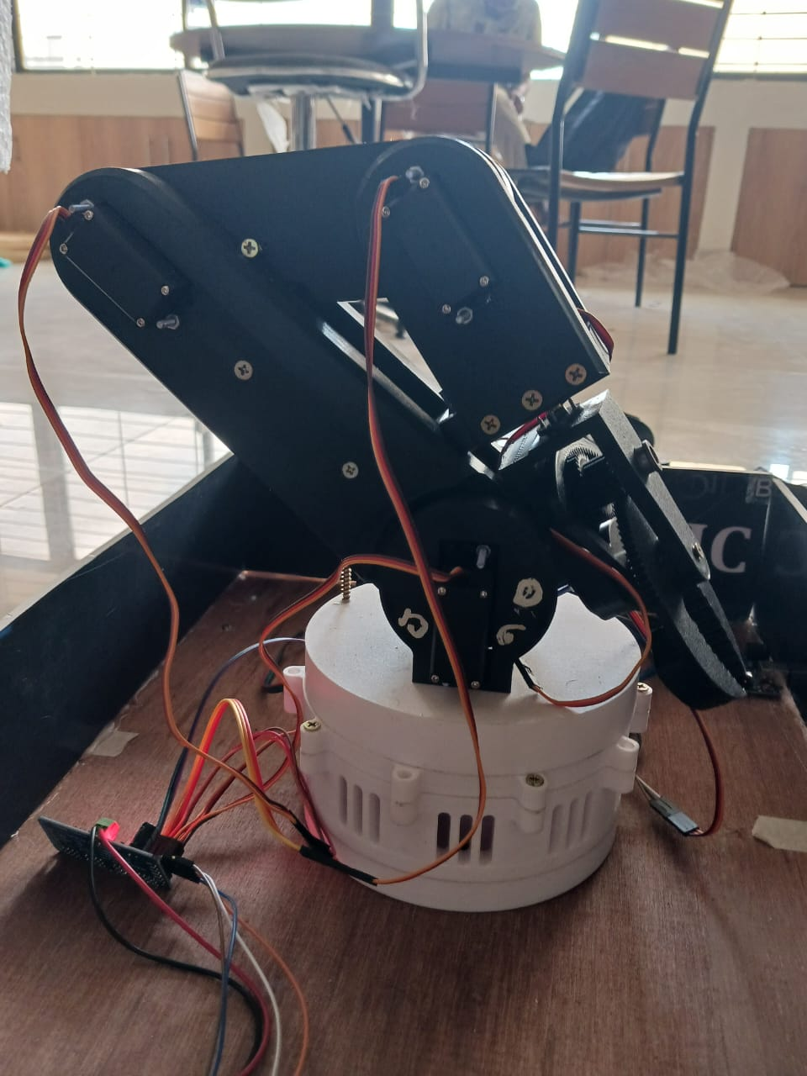
Robotic Arm
Precision and Accuracy
Efficient and Fast
Versatility and Adaptability
Enhanced Safety
Improved Customer Experience

Slide 13
Inclusion of Robotic Arm
Collaboration with Line-Following Robot
Mechanism Overview
Gripping Mechanisms
Sensor Integration
Control and Automation
Safety Precautions

Slide 14
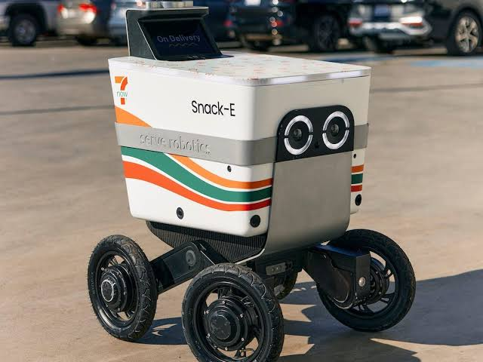
Sending to Customers
Transport: Food delivery robot

Slide 15
Problems Faced
Integration of website to the cart.
Arm calibration.

Slide 16
Limitations
Very small size product like paprika cannot be picked.
Very large size product cannot be picked.
Camera quality is not quite high.
Cannot pick product of weight higher than 400 grams.

Slide 17
Individual Contribution
User interface to select product and visualization of product to customer → 1906150, 1906151
Line Follower implementation → 1906149, 1906152
Robotic Arm design, calibration, peaking the product and reach to the destination → 1906153, 1906154
Integration of total project → 1906149

Slide 18
References:
[1] S. Sakib, A. Chowdhury, S. T. Ahamed and S. I. Hasan, "Maze solving algorithm for line following robot and derivation of linear path distance from nonlinear path," 16th Int'l Conf. Computer and Information Technology, Khulna, Bangladesh, 2014, pp. 478-483, doi: 10.1109/ICCITechn.2014.6997314.
[2] Rashid, Abdulmuttalib & Ali, Fatima & Rashid, Osama. (2018). Design and Construction Objects Store System using Line Follower Robot. International Journal of Computer Applications. 181. 27-35. 10.5120/ijca2018917773.
[3] H. M. Hameed, A. T. Rashid and K. A. Al Amry, "Automatic Storage and Retrieval System using a Single Mobile Robot," 2020 International Conference on Electrical, Communication, and Computer Engineering (ICECCE), Istanbul, Turkey, 2020, pp. 1-6, doi: 10.1109/ICECCE49384.2020.9179180.
[4] Existing Project: https://www.researchgate.net/figure/Usability-tests-with-two-robots-in-a-larger-grocery-store-Both-CompaRob-and-CompaRob-2_fig6_293479658

Slide 19
Thank You

